Slide 1

AIR Tracker
Automated and Intelligent Reporting of the baggage-handling process
a milestone presentation from CS 410
Green Group
presented by Alex Hitchens
Wednesday, November 19, 2008
19 November 2008 AIR Tracker <number>

Slide 2

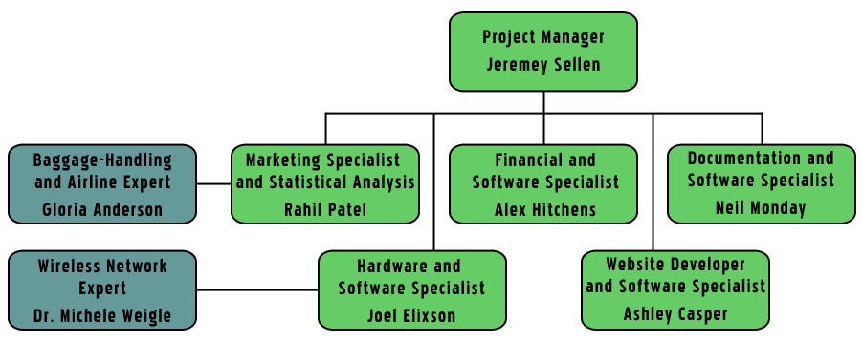
Organizational Chart
19 November 2008 AIR Tracker <number>

Slide 3
Overview
Problem Description
Solution Description
Process Description
Solution Characteristics
Management Plan
Evaluation Plan
Marketing Plan
Funding Plan
Risk Management Plan
Competition Analysis
Staffing Plan
Milestones and Deliverables
Conclusion
19 November 2008 AIR Tracker <number>

Slide 4
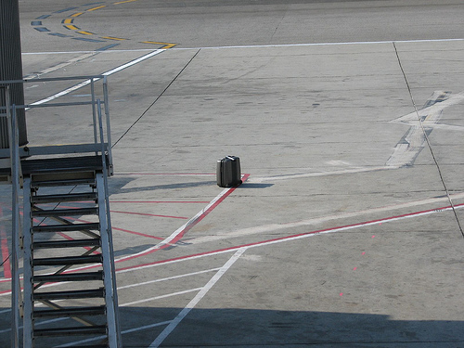
Lonely Bag Dropped from Cart
19 November 2008 AIR Tracker <number>

Slide 5
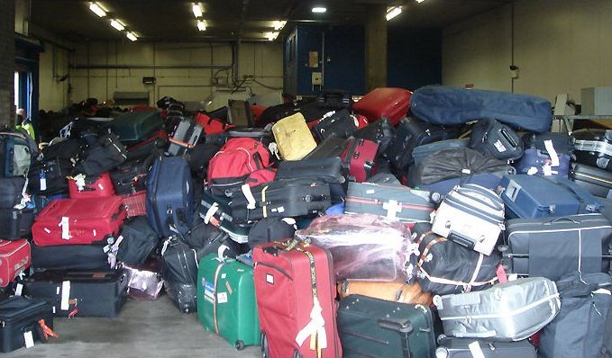
And Where Do These Bags Go?
19 November 2008 AIR Tracker <number>

Slide 6
Has This Ever Happened to You?
John is flying from Los Angeles to a very important client meeting in Norfolk.
His self-made business hinges on the success of this sale, and he has a lot of equipment to bring.
Federal regulations limit the number of bags he can carry on the plane with him. He must check two of them.
Upon reaching Norfolk, John heads to the luggage carousel to wait for his bags, but they never come.
John proceeds to talk with the personnel at the luggage claim office and has to fill out a form about the missing bags.
19 November 2008 AIR Tracker <number>

Slide 7
What Happens Next?
Scenario #1
- John is told that his bags are in Atlanta.
- Perplexed, he asks how this could have happened.
The airline assistant does not necessarily have an
answer for him.
- John will be unable to get his equipment in time for
the meeting and risks canceling his business
meeting.
Scenario #2
- John is told that his bags are not showing up in
the system.
- Confused, he asks how this could have happened.
The airline assistant does not have an answer
for him.
- John will possibly never see his equipment again
and will have to cancel the entire trip’s business.
19 November 2008 AIR Tracker <number>

Slide 8
An Expert’s Words
“Baggage handlers drop more bags [off a cart] than they put baggage on the wrong flight.”
“We’ll never know how many bags, when found to be missing from a flight, make it onto the right plane. Those statistics aren’t calculated.”
“The carry-on versus checking issue is becoming more important because people are cheap. They refuse to check bags, but now, airlines can get fined thousands of dollars if a passenger carried more than two carry-ons onto a plane.”
- Gloria Anderson, baggage handler at Norfolk International Airport
19 November 2008 AIR Tracker <number>

Slide 9
Problem Description
In spite of current quality assurance measures, airlines spend billions of dollars a year on mishandled luggage.¹ This includes the funding to support the extra personnel to transport the bags to the individuals and also to reimburse travelers who’s bags have been lost.
1) Customer Relationship Management (CRM) Daily; in this case, “mishandled” means dropped, left behind, or mistakenly sent to the wrong area or plane.
19 November 2008 AIR Tracker <number>

Slide 10
Solution Description
The AIR Tracker software solution will augment existing systems at airports utilizing technology that already exists.
Using the existing RFID antennae and bar code scanners that register the bag’s location, AIR Tracker will track and report on the routing of luggage in airports as well as offer a real-time account of luggage statistics on the luggage carts.
AIR Tracker will utilize wireless and RFID technologies between carts and wireless access points that transfer that data back to the main database.
19 November 2008 AIR Tracker <number>

Slide 11
Solution Characteristics
AIR Tracker, by using existing technology at airports, will be customized for the layout of every airport.
AIR Tracker will be an augmented reporting system for existing luggage routing mechanisms.
AIR Tracker will provide comprehensive reports to assist the airport in pinpointing problem areas in their handling process, thereby reducing the amount of mishandled luggage.
19 November 2008 AIR Tracker <number>

Slide 12
Facilitating the Tracking Process
AIR Tracker will utilize existing technology, including bar codes, RFID tags, and databases, at airports in order to
identify bags that have been dropped,
identify bags that have been left behind,
report on the overall baggage handling for each bag,
and assist the airport in pinpointing trouble spots in
current baggage handling processes.
19 November 2008 AIR Tracker <number>

Slide 13
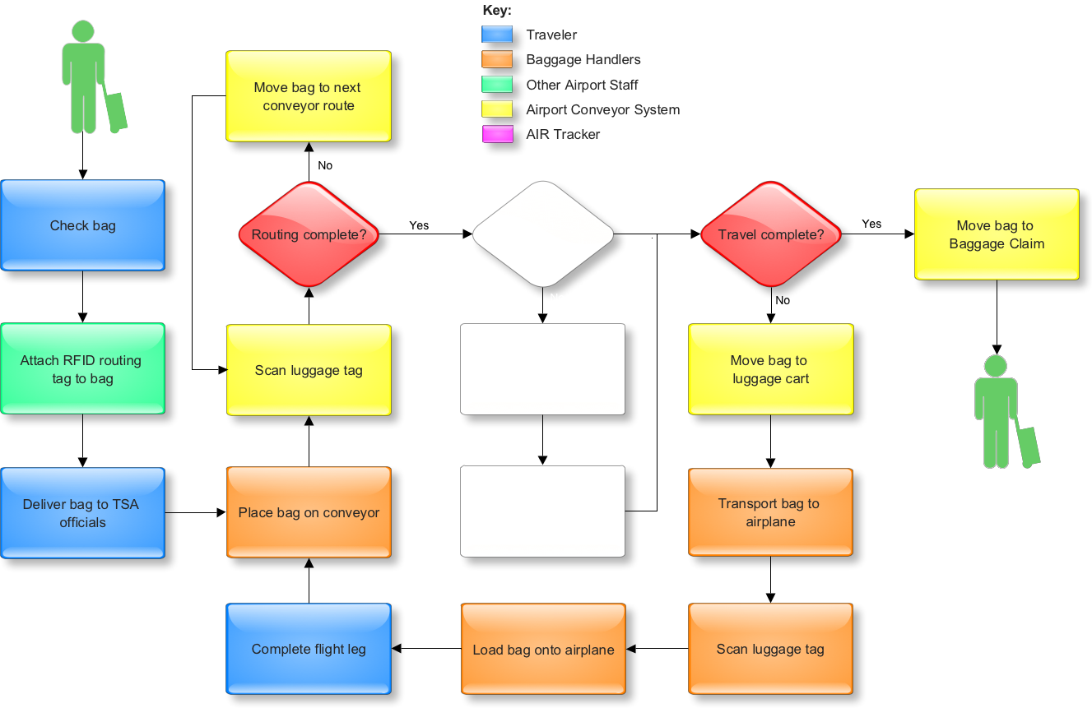
Process Before AIR Tracker
19 November 2008 AIR Tracker <number>

Slide 14
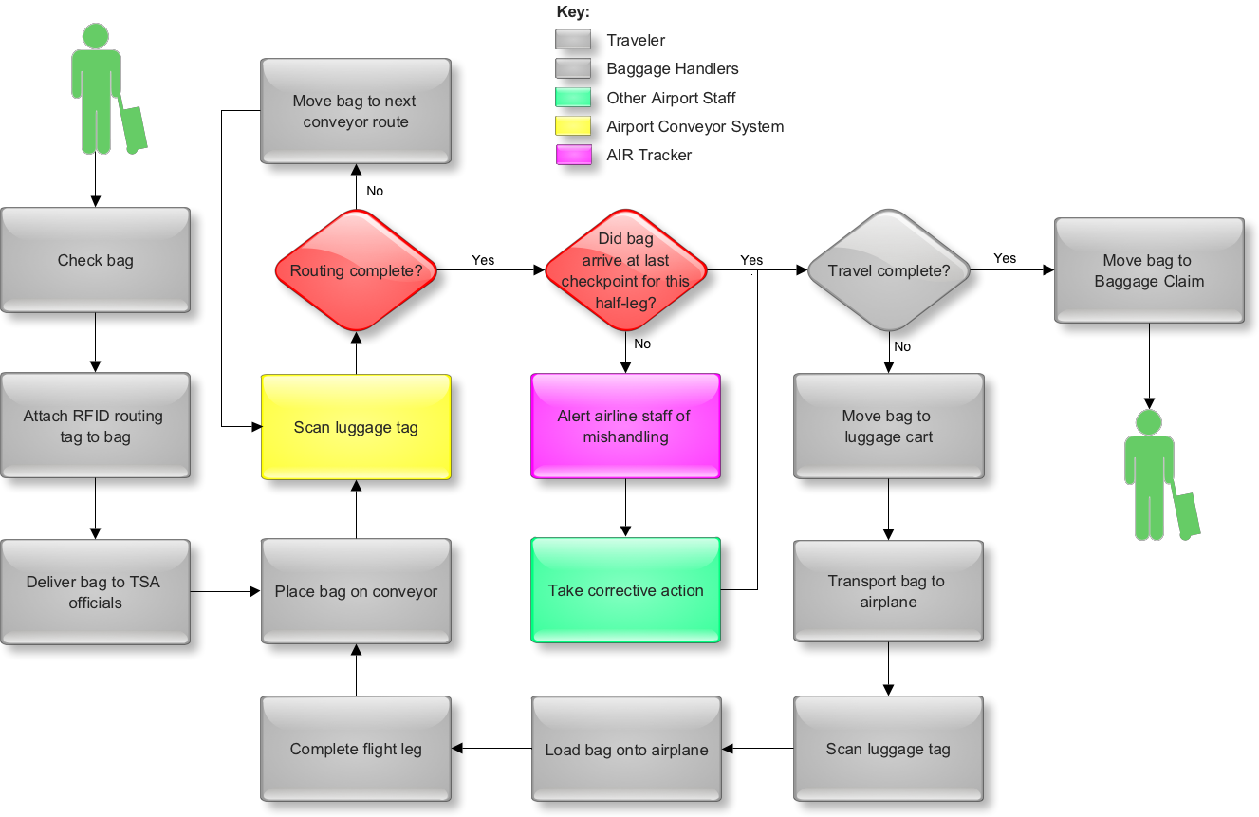
Process Utilizing AIR Tracker
19 November 2008 AIR Tracker <number>

Slide 15
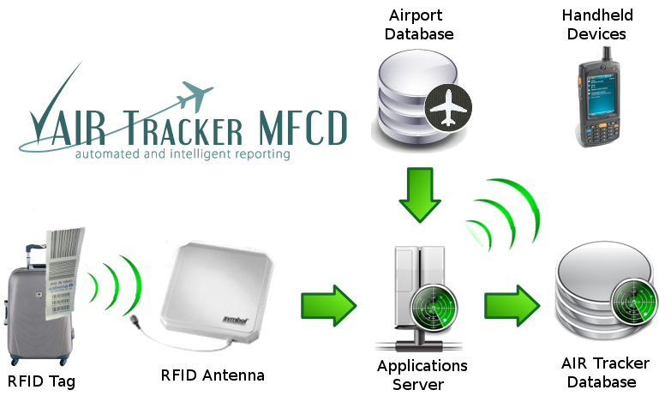
AIR Tracker MFCD
19 November 2008 AIR Tracker <number>

Slide 16
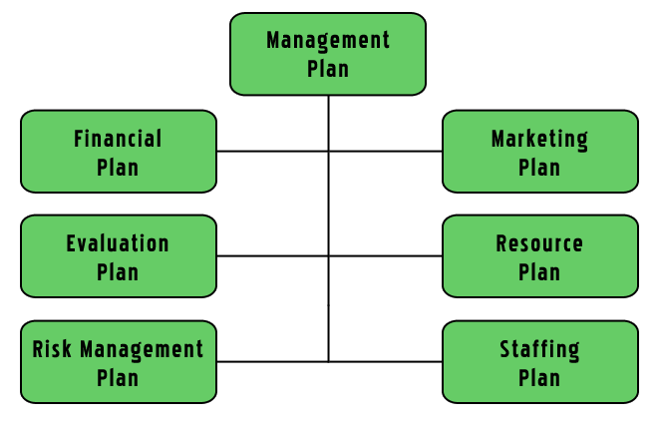
Plan Breakout
19 November 2008 AIR Tracker <number>

Slide 17
Management Plan – The Team
Since AIR Tracker is primarily a software solution, the team has put a heavy emphasis on this expertise. Each member will contribute to the project as a software specialist, thereby using all of the team’s collective skills in the programming process.
The structure of the team includes each member having direct access to the project manager regarding his specific portion of the project. When the team moves on to Phase 1, a head programmer will be included and will interface between the project manager and the other programmers.
19 November 2008 AIR Tracker <number>

Slide 18
Management Plan – Communication
The AIR Tracker team meets three times a week (Monday, Wednesday, and Friday) from 1 p.m. to 4 p.m. The team uses this time for collaboration and to provide feedback on the work in individual areas.
In addition to meeting times, the AIR Tracker team interacts via online forums.
The team tracks its progress through milestones and a tasking list.
19 November 2008 AIR Tracker <number>

Slide 19
Evaluation Plan
AIR Tracker beta testing will begin at smaller airports, such as Norfolk International. Utilizing frequent fliers at first, the implementation will be gradual but consistent from the first day of testing.
Of all fliers who have bags mishandled at airports, frequent fliers risk the most and would be the most efficient customers for airports to test.
Each checkpoint at which a bag is scanned will be collected and kept in the AIR Tracker database. Generated reports will assist in analyzing problem areas in the baggage handling process.
Preliminary analysis of the risks of beta testing include software issues. To prevent problems with the massive amount of data that the system may incur, careful design will be needed in addition to extensive testing before the beta tests.
19 November 2008 AIR Tracker <number>

Slide 20
When We Will Know Success
The cost of returning a mishandled bag to its owner, including fuel, manpower, and ground transportation costs, is estimated at around $90 by the International Air Transport Association.¹ Airlines currently lose approximately seven bags per 1000.
Southwest Airlines, for example, flies over 104 million passengers a year.²
That would conservatively equal approximately 728,000 mishandled bags a year, costing $65.5 million.
If only three bags were lost per 1000, airlines would save almost $40 million.
Saving one bag in 1000 saves almost $10 million.
1) MSNBC.com
2) Southwest.com
19 November 2008 AIR Tracker <number>

Slide 21
Marketing Plan
Since AIR Tracker is targeted at airports, the team will utilize personal marketing visits in order to market the product.
Smaller airports will be used for beta testing. Success at these sites will entice larger airports to purchase AIR Tracker.
Airports with an especially high rate of mishandled bags are a potential target market.
19 November 2008 AIR Tracker <number>

Slide 22
Marketing Plan – Niche
AIR Tracker easily integrates with existing systems.
AIR Tracker customizes to fit the airport.
AIR Tracker’s cart sensor gives additional feedback to baggage handlers at the site.
19 November 2008 AIR Tracker <number>

Slide 23
Phase 1 Staff Costs
Title | Quantity | Time Needed | Hourly Rate | Total
Project Manager | 1 | 640 hours | $15 | $9,600
Hardware Manager | 1 | 320 hours | $15 | $4,800
Software Manager | 2 | 520 hours | $15 | $15,600
Marketing Director | 1 | 80 hours | $15 | $1,200
Financial Specialist | 1 | 160 hours | $15 | $2,400
Webmaster | 1 | 80 hours | $15 | $1,200
Wireless Consultant | 1 | 30 hours | $15 | $1,050
Transportation Consultant | 1 | 70 hours | $15 | $840
Database Analyst | 1 | 400 hours | $15 | $6,000
 |  |  |  | $42,690
 |  |  | 40% Overhead | $17,080
Totals | 10 | 2,300 hours | - | $59,770
19 November 2008 AIR Tracker <number>

Slide 24
Phase 1 Resource Costs
RFID receiver - $150
RFID tags - $10
______________________________
Grand Total: $160
19 November 2008 AIR Tracker <number>

Slide 25
Phase 2 Staff Costs
Title | Salary | Time Needed | Hourly Rate | Total
Project Manager | $62,000 | 640 hours | $30 | $19,000
Hardware Manager | $58,000 | 160 hours | $28 | $8,960
Software Manager | $104,000 | 520 hours | $50 | $24,960
Marketing Director | $82,000 | 80 hours | $40 | $3,200
Financial Specialist | $45,000 | 160 hours | $22 | $3,520
Webmaster | $64,000 | 80 hours | $24 | $1,840
Wireless Consultant | $52,000 | 70 hours | $25 | $1,750
Transportation Consultant | $24,000 | 70 hours | $12 | $840
Technical Writer | $58,000 | 160 hours | $28 | $4,480
Outsourced Electrician | $42,000 | 160 hours | $21 | $3,360
Database Administrator | $80,000 | 80 hours | $39 | $3,120
 |  |  |  | $75,030
 |  |  | 40% Overhead | $30,010
Totals | - | 2,180 hours | - | $105,040
19 November 2008 AIR Tracker <number>

Slide 26
Phase 2 Resource Costs
RFID receiver - $150
Wireless antennae - $250
Portable scanners - $300
RFID tags - $10
Oracle 11g license - $10,000
Dell PowerEdge 2900 III - $15,000
______________________________
Grand Total: $25,710
19 November 2008 AIR Tracker <number>

Slide 27
Marketing Plan – Price Point
Hardware + Software = $50,000
- Even if AIR Tracker only reduces mishandled bags
by one bag per 1000, airports using AIR Tracker
will find that the system pays for itself in the first
year.
- With an estimated cost of salaries and upkeep in
Phase 3 nearing $900,000, the AIR Tracker team
would need to sell 37 systems to begin seeing
profit.
19 November 2008 AIR Tracker <number>

Slide 28
Funding Plan
Phase 1 – NSF SBIR Grant (up to $100,000)
Phase 2 – NSF SBIR Grant (up to $750,000)
Phase 3 – Federal Aviation Administration Grant
- Airport Improvement Program (20.106)
- $12,000 to $35 million
- average grant: $1.25 million
- Small Business Loans
19 November 2008 AIR Tracker <number>

Slide 29
Risk Management Plan
AIR Tracker’s main area of risk outside of poor marketing is wireless communications.
Some installation of new equipment may be required.
AIR Tracker’s signals may be affected by other signals.
The implementation of several technologies on one device may pose a problem.
Risk analysis and a detailed mitigation plan will aid in reducing AIR Tracker’s risk.
19 November 2008 AIR Tracker <number>

Slide 30
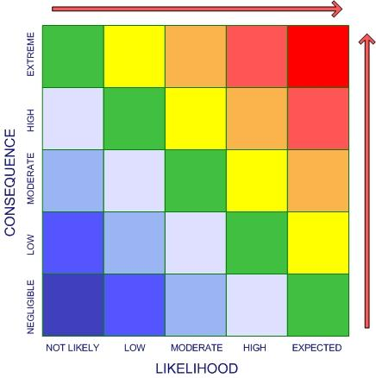
Risk Analysis
Initial Risks
1. Not Enough Airports Attracted
2. Unintentional Personal Information Leak
3. Incompatible Database Format
4. Customers Unable to Install SW/HW
5. Wireless Communication Problems
2
1
3
4
5
Mitigation of Risks
1. Solid Marketing
2. Solid Database Security
3. Customized Database Queries and Extensive Research
on Existing Databases
4. Extensive and In-Depth Training
5. In-Depth Research and Maximized Wireless
Implementation
19 November 2008 AIR Tracker <number>

Slide 31
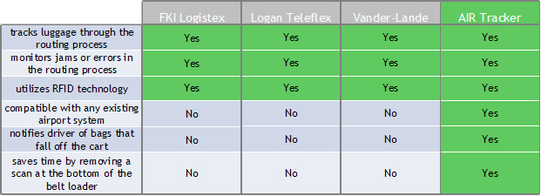
Competition Analysis
19 November 2008 AIR Tracker <number>

Slide 32
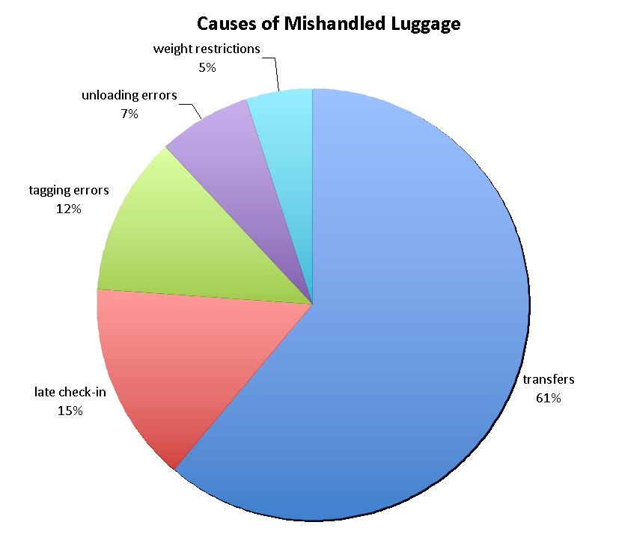
AIR Tracker Versus Competition
Although the competition helps to solve each facet of the mishandled luggage problem, AIR Tracker supplements their capabilities.
1
1) Popular Mechanics
19 November 2008 AIR Tracker <number>

Slide 33
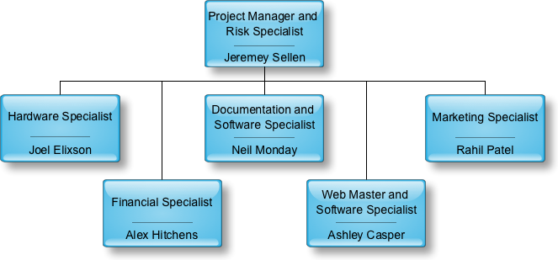
Staffing Plan: Phase 0 Organization
19 November 2008 AIR Tracker <number>

Slide 34
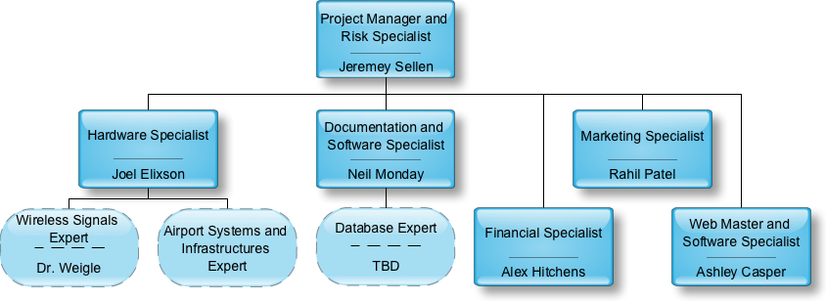
Staffing Plan: Phase 1 Organization
19 November 2008 AIR Tracker <number>

Slide 35
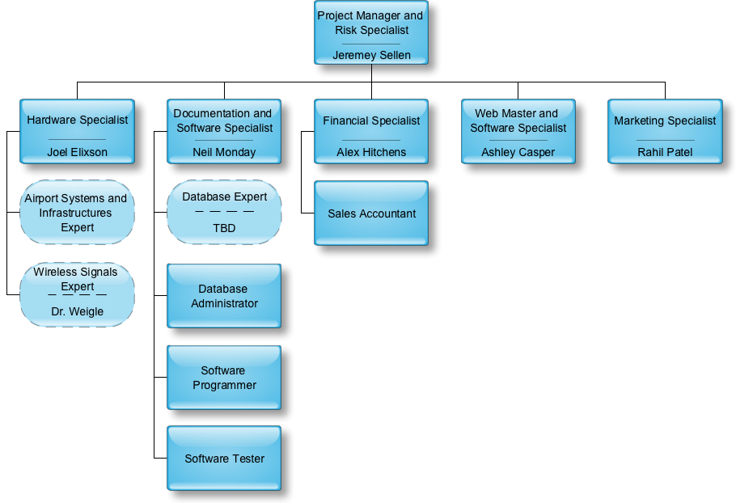
Staffing Plan: Phase 2 Organization
19 November 2008 AIR Tracker <number>

Slide 36
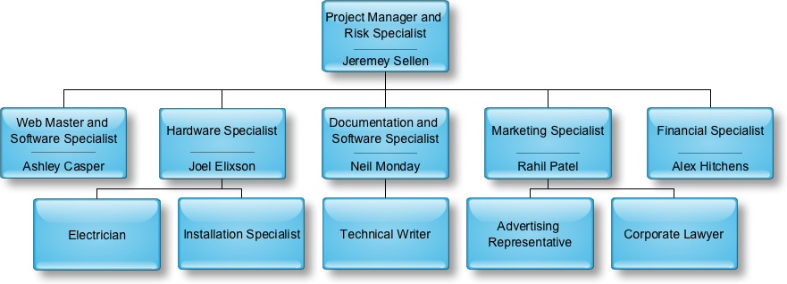
Staffing Plan: Phase 3 Organization
19 November 2008 AIR Tracker <number>

Slide 37
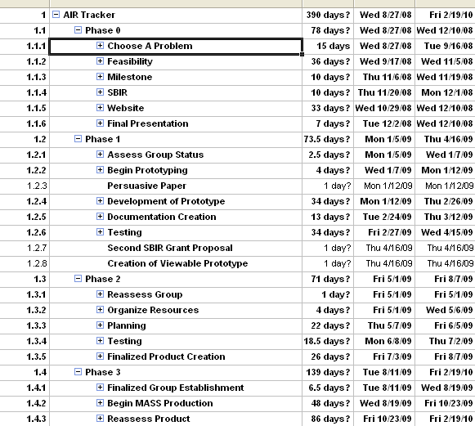
Milestones
19 November 2008 AIR Tracker <number>

Slide 38
Deliverables
Phase 0 (Product Conception)
Feasiblity, Milestone, Final, SBIR, Website
Phase 1 (Proof of Concept)
Creative, Descriptive, Technical, Budget, and User
Papers; Design Prototype; Develop Prototype;
Market and Survey Research; Website; SBIR (Part 2)
Phase 2 (Working Production Model Development)
Management Plan, Product Design Specifications,
Testing and Evaluation Plan, Working Production
Model, Market Plan and Contracts
Phase 3 (Production)
Consumer Acceptance and Requirements, Sales
Contracts, Maintenance and Support Handling,
Product Documentation, Product Release
19 November 2008 AIR Tracker <number>

Slide 39
Conclusion
Mishandled luggage costs unnecessary resources, including money, time, and personnel. The process in place has inherent flaws, and in order to locate these areas and provide the most efficient operations and customer service, AIR Tracker should and must be employed.
19 November 2008 AIR Tracker <number>

Slide 40
References
“Air Travel Consumer Reports for 2008.” airconsumer.ost.dot.gov. 30 JUL
2008. Office of Aviation Enforcement. 01 Oct 2008 <http://airconsume
r.ost.dot.gov/reports/atcr08.htm>.
“Airport IT Trends Survey 2008.” sita.aero. SITA. 21 Oct 2008 <http://www
.sita.aero/News_Centre/Industry_surveys_and_trends/Airport_IT_trends
/default.htm>.
Bevan, Judi. “Coping with crisis, climate change — and lost luggage.”
spectator.co.uk. 07 Nov 2007. The Spectator. 20 Oct 2008 <http://ww
w.spectator.co.uk/the-magazine/business/334921/coping-with-crisis-cli
mate-change-and-lost-luggage.html>.
Bicknell, David. “Airlines reject RFID as universal industry solution to
lost bags.” ComputerWeekly.com. 30 Jul 2008. Computer Weekly. 20
Oct 2008 <http://www.computerweekly.com/Articles/2008/06/20/2311
41/airlines-reject-rfid-as-universal-industry-solution-to-lost.htm>.
“Frequently Asked Questions.” globalbagtag.com. Global Bag Tag. 20
Oct 2008 <http://www.globalbagtag.com/faq.cfm>.
Halthore, Mukund. “RE: Contact request from website (Germany).” Email to
Joel Elixson concerning the wholesale cost of GPS/GSM modules. 21 Oct
2008.
“IBM System x3450.” IBM. 2008. IBM. 21 Oct 2008 <http://www-304.ibm.co
m/shop/americas/webapp/wcs/stores/servlet/default/CategoryDisplay
?categoryId=4611686018425232005&storeId=1&catalogId=-840&langId=
1>.
James, Andrea. “Seattle firm sues British Airways over lost luggage.”
Seattle PI. 13 Nov 2007. Seattle PI. 21 Oct 2008 <http://seattlepi.nwso
urce.com/business/339434_lostluggage13.html>.
“Job Salaries-Performance Reviews-Compensation software- Salary.com.”
2008. Salary.com. 04 Nov 2008 <http://www.salary.com>.
19 November 2008 AIR Tracker <number>

Slide 41
References
10) Levy, Francesca. “The Airlines’ Bag Reflex.” BusinessWeek.com. 30 Jul
2008. Business Week. 20 Oct 2008 <http://www.businessweek.com/life
style/content/jul2008/bw20080729_355085.htm>.
11) Mummolo, Jonathan. “Now Arriving At Carousel 1, Far Fewer Of Your
Bags.” Washingtonpost.com. 01 Oct 2007. Washington Post. 20 Oct 20
08 <http://www.washingtonpost.com/wpdyn/content/article/2007/09
/30/AR2007093001653.html?sid=ST2007100200809>.
12) Scottberg, Erin. “Anatomy of Lost Luggage: How to Track Your Bags
(and Save ’Em).” Popular Mechanics. 20 Dec 2007. Popular
Mechanics. 21 Oct 2008 <http://www.popularmechanics.com/technolo
gy/transportation/4237628.html>.
13) “Software Engineer / Developer / Programmer Job Salaries in Virginia
Beach-Norfolk-Newport News, VA-NC.” PayScale. 2008. 21 Oct 2008
<http://www.payscale.com/af/calc.aspx?job=program mer&city=Norfo
lk&state=VA>.
14) “IB Technology 125 kHz RFID Antenna.” Trossen Robotics. 2008. Trossen
Robotics. 04 Nov 2008 <http://www.trossenrobotics.com/ib-technology-
125-khz-rfid-antenna.aspx?feed=Froogle>.
19 November 2008 AIR Tracker <number>

Slide 42
Questions?
19 November 2008 AIR Tracker <number>

